Slide 1
User Testing Guide: {{App Name}}
{{Date}}

Slide 2
Why did we build this App? [Example]
Aligning our tools to help our team goals
Compliance
Self-Serve
Compliant-by-design tools that are maintained by the legal team with up-to-date templates.
Improving the way business users can self-serve legal simple legal requests without needing to involve the legal team.
Data Analytics
Better Experience
All requests can be viewed in a centralised dashboard where analytics can be drawn.
Faster turn-around by standardising the process.

Slide 3
User Journeys Covered [Example]
There are multiple users involved in this process – they are:
1
They should be able to:
Find a link to the App from the company portal
Self-serve simple legal matters such as an NDA under $500,000.
Easily escalate complex legal matters to the legal team.
Be notified of any updates to their matter.
Business Users
2
They should be able to:
Be notified for complex legal matters with all the information they need to provide advice.
Track all legal requests from a centralised dashboard.
Legal Team

Slide 4
Key Outcomes
What feedback are we looking for?
CONTENT
Is this the information the end-user should see? This involves questions and tips/on-screen guidance.
LOGIC
Did the App flow the way it is intended? This can be calculations, smart forms and routing pathways. Errors such as “Could not retrieve next page” is an error in logic.
USER EXPERIENCE
How will the end-user feel about using this App? Ways to reduce the number of clicks and extra guidance where necessary are methods of improving user experience.

Slide 5
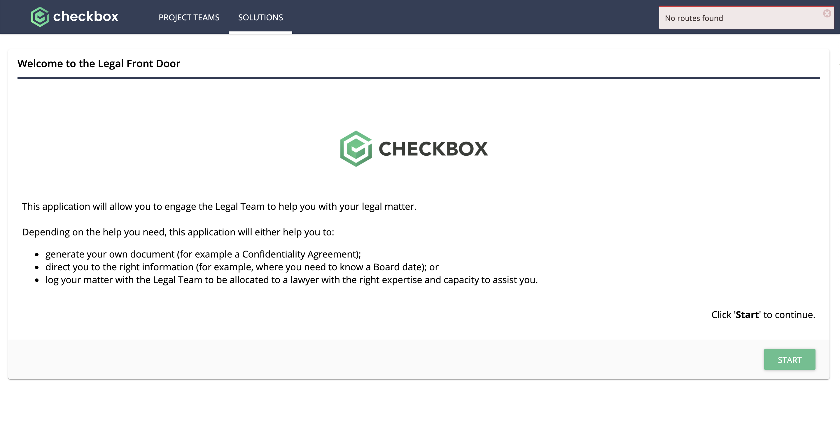
Key Outcomes
Logic errors are flagged here
Content includes anything on the forms

Slide 6
Testing the App
How to access the tool and where to provide feedback
Access the App here (details around logging in, if applicable) {{LINK to App}}
Add any feedback here {{LINK to feedback log}} before {{Deadline}}
Contact {{Number}} for any questions.

Slide 7
{{Contact Name}}
{{Contact Email}}

